Slide 1
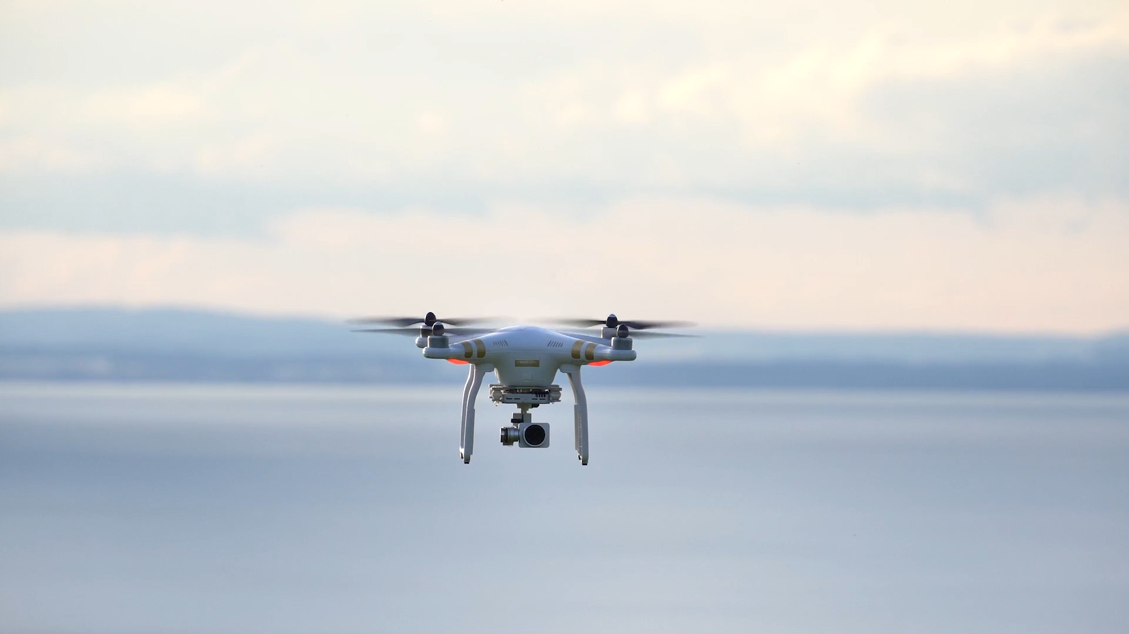

Population Density Data API
Discussion on the CAMARA Definition

Slide 2
API Population Density Data - Introduction
API Description
The Population Density Data API enables developers with the capability to get population density estimations for a specific area at a future date and time, considering historical anonymized information of the network connected devices in the requested area.
For the reference use case, the API fills the need of assessing the ground risk to allow safe drone flights by providing estimations of the number of people under a drone flight path. This assessment will be needed every time a drone flight in the specific category need to conduct an operation and will help the operator to identify operational limitations, to develop the appropriate operational procedures and to identify mitigations and safety objectives.
Use cases (examples)
Use Case (1): Providing BVLOS (Beyond Visual Line of Sight) flights with the information to meet SORA 2.5 (Specific Operation Risk Assessment) requirements in terms of intrinsic Ground Risk Class (iGRC).
Use Case (2): Providing information to identify if the ground risk class for a given drone flight path is acceptable for the time of the flight, or an alternative time (or zone) should be considered to lower the risk.
Benefits
Safe Drone Flights: by providing a provision of people density datasets for Drone Operators to avoid flight routes over areas with crowds on the ground.
Achieve SORA approval: by providing services that help Drone Operators to perform the regulatory Ground Risk Assessment and to identify if there is a need of developing appropriate operational procedures and mitigations.
Drone Route Planning: by identifying the best route and timing in terms of ground risk.
Inputs/outputs
Input: Geographical area (2D map) and time range (future).
Output: Max, min and average estimated statistics of population density for the required map, divided in uniform cells depending on the accuracy of the data. In a time series, to include information for the complete requested time range.

Slide 3
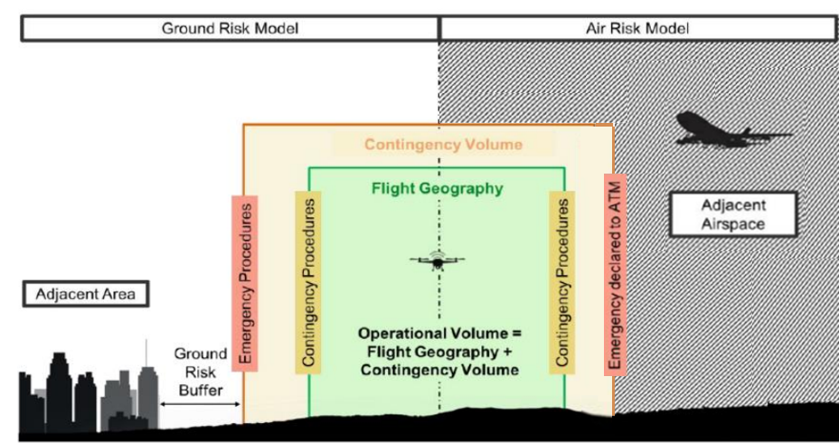
Reference Use Case:
Population Density will be calculated for a space containing the flight areas involved and defined before the request of the flight plan authorization
The ground risk calculation for SORA 2.5 regulation is divided into 2 main spaces:
(1) iGRC Score Footprint:
Operational Volume: Flight Geography + Contingency Volume.
Ground Risk Buffer.
(2) Adjacent Area.
For each space, the population density data should provide means to calculate:
iGRC Footprint
Highest number of people
Adjacent Area
Average number of people
iGRC: Intrinsic Ground Risk Class SORA: Specific Operational Risk Assessment

Slide 4
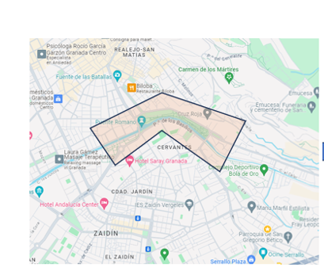
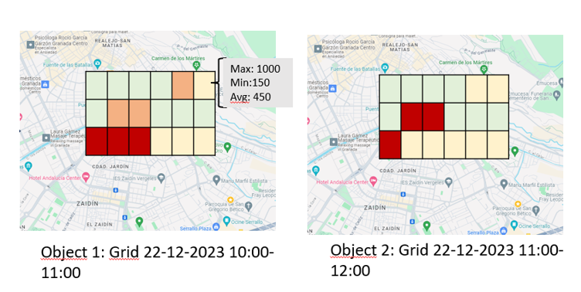
API Inputs and Outputs
The API will receive requests for Risk Assessments for a flight with the following input parameters:
2D Polygon: delimited physical 2D area for the specific flight plan in a polygon format.
Date & time range for the planned flight in CET Format:
Start Date: from 15 minutes to one year from the moment of the request.
End Date: Considering a maximum duration TBD.
The output data shall be:
A dataset consisting of a sequence of objects. Each of which consist of a quadrangular object containing the input polygon in a grid subdivision with uniform cells (the side of which corresponds to the location accuracy offered).
In each of the cells of the grid, a series of estimated statistics will be reported for each date and time within the range. For example, if the entry date range was [2023-12-22 11:25 AM to 2023-12-22 PM] it would contain 2 hours (11:00-12:00 AM and 12:00-1:00 PM band), which would return 2 grids, with the following aggregated data record for each grid cell: Maximum Expected Population, Minimum and Average.

Slide 5
Key aspects to discuss amongst MNOs
Output calculation: It will be calculated based on an aggregate number of devices/SIM cards connected to the mobile network, discriminating those that are classified as IoT/M2M. Data should be anonymized prior to aggregation.
Spatial Indexing: Partitioning the polygon into smaller uniform units (e.g.: G7 geohashes).
Prediction Model: The output data refers to a date in the future. Then the output will be based on a prediction model. Basic implementation: Average population in the past X weeks on same day-time, e.g. for a Tuesday 11:45, the number of people "attributed" to the area on the N preceding Tuesdays at the same time/hour.
Extrapolation of the people amount from the number of detected SIM cards (from 1 or many MNOs):
The extrapolation algorithm should be statistically robust specially when accommodating outputs from several MNOs (abundant research available).
MNO market share is a key parameter to design the extrapolation method, in addition to considering people with no devices.
GDPR/Privacy: No output values will be provided for subunits below 15 people/km2.
Compliance of outputs with interfaces defined by the UAS regulation (link to GSMA Aerial Connectivity Joint Activity – ACJA).

Slide 6
CAMARA SCOPE and EXPECTED TIMELINE
This service API not only considers a basic question-response service, but an interpolation and prediction logic.
CAMARA is expected to provide not only the .yaml API specification but also the guidelines for internal service logic, ensuring a homogeneous response among operators.
API User story and Scope proposal
API flows and parameters, including algorithm
YAML file proposal
YAML filed approval and documentation creation
Now → 07 February
(initial proposal)
07 February → 21 February
07 February → 21 February
(initial proposal)
21 February → 06 March
(RC proposal)

Slide 7
API SCOPE – Use cases
(Drones) Population Density prediction as an input for the risk assessment before a drone flight starts, during the planning.
Outputs are based on future prediction, inputs from API
Any other to include? → offline discussion to confirm

Slide 8
References
EASA SORA specification: https://www.easa.europa.eu/en/domains/civil-drones-rpas/specific-category-civil-drones/specific-operations-risk-assessment-sora
SORA 2.5 Methodology (short introduction): https://eudroneport.com/blog/sora-2-5/
How to calculate the iGRC (intrinsic Ground Risk Class) for Sora 2.5: https://www.easa.europa.eu/en/downloads/137614/en
GSMA ACJA (Aerial Joint Activity): https://www.gsma.com/iot/advanced-air-mobility-resources/

